Slide 1
A-421
Advanced stainless steel for knives and cutlery

Slide 2
A-421: A new advanced stainless knife steel
A-421 is a new advanced martensitic stainless steel developed for knives and cutlery
    High hardness (~62 HRC)
    Excellent corrosion resistance, even in hot, moist salt fog after long periods of time
    No chromium carbide particles
    Uniform hardness throughout
    Outstanding edge retention as shown from CATRA testing (ICP and TCC)
    Wrought, not made from powder
    Fine blankable, to facilitate making blanks
    Made in U.S.A., melted, forged, rolled, finished, and tested entirely in America
Melt types:
  Standard: Vacuum arc remelt (VAR)
  Premium: Vacuum induction melt - vacuum arc remelt (VIM-VAR)
  Air melt: Upon request

Slide 3
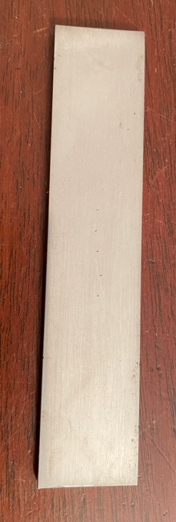
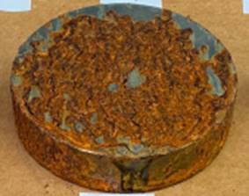
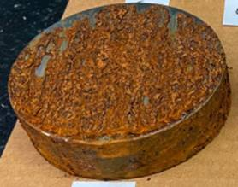
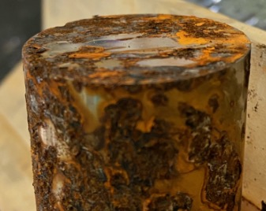
A-421 salt fog corrosion test (ASTM B117) after 200 hours
A-421 (62 HRC)
Constant exposure at:
95°F (35°C)
100% humidity
5% NaCl fog solution
440C (58 HRC)
BG-42 (61 HRC)
CPM S90V (58 HRC)

Slide 4
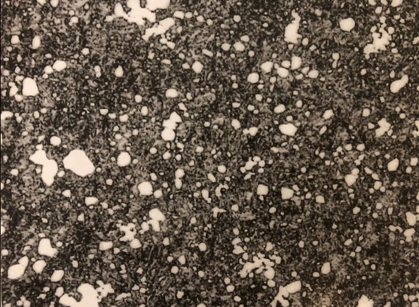


A-421 microstructure
BG-42
440C
A-421
20µm
20µm
10µm
Microstructure comparison
BG-42 and 440C microstructures have large Cr-carbides
A-421 microstructure has a small, uniform distribution of TiC particles
Most carbon in A-421 is dissolved in the matrix between the TiC particles,
creating uniform hardness and excellent edge retention

Slide 5

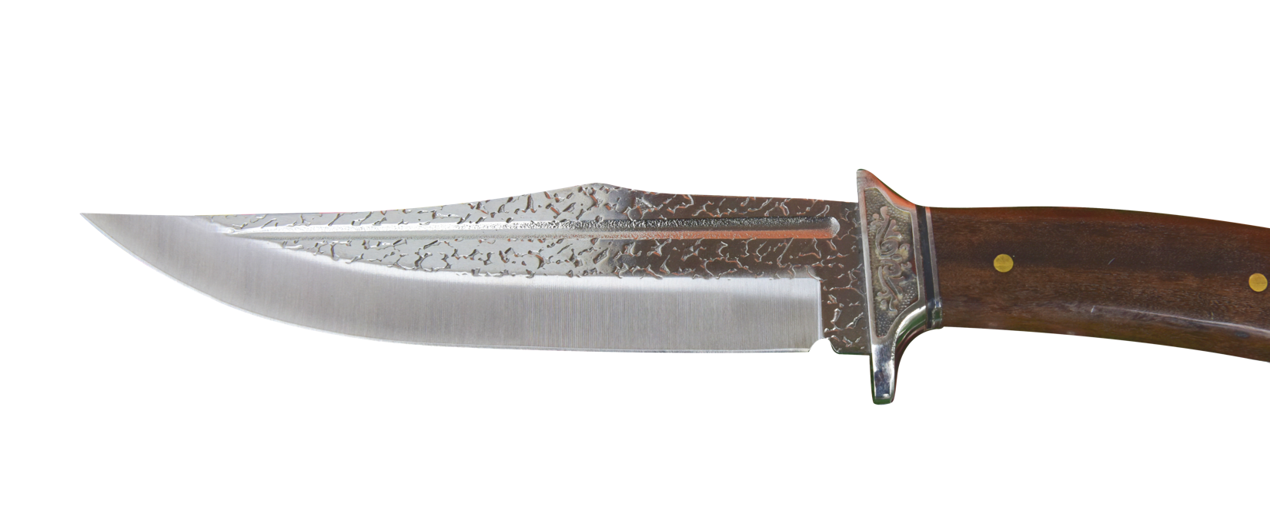
A-421 process route
  A-421 plate (sheet) is made in the USA
  A-421 sheet is shipped in the annealed condition (302 BHN, max)
  Knife profile is cut from plate (laser/water jet/stamped/EDM)
  Bevel is added to knife preform
  Knife preform is fully hardened
  Blade is sharpened with minimal heat input
  Knife is finished

